Slide 1







PROJECT NAME– FAKE NEWS DETECTION
MENTOR—MS SHREYA MAM

Slide 2



A
P R O J E C T R E P O R T
O N
FAKE NEWS DETECTION
U S I N G P Y T H O N
B Y
ISHAN SHARMA
R I S HITA S SAXENA
MANNU CHAURASIYA
PIYUSH SATI

Slide 3





OBJECTIVE --
1 - - T H E F A K E
M A I N O B J E C T I V E N E W S , W H I C H I S
C L A S S I F I C A T I O N
I S T O D E T E C T T H E
A C L A S S I C T E X T
P R O B L E M W I T H A
I S
S T R A I G H T F O R W A R D P R O P O S I T I O N . I T
N E E D E D T O B U I L D A M O D E L T H A T C A N D I F F E R E N T I A T E
B E T W E E N “ R E A L ” N E W S A N D
“ F A K E ”
N E W S

Slide 4




02 The aim of this work is to create a system or model that can use the data of past news reports and predict the chances of a news report being fake or not

Slide 5



ABSTRACT
STUDIO SHODWE
The fake news on social media and various other media is wide spreading and is a matter of serious concern due to its ability to cause a lot of social and national damage with destructive impacts. A lot of research is already focused on detecting it. This paper makes an analysis of the research related to fake news detection and explores the traditional machine learning models to choose the best, in order to create a model of a product with supervised machine learning algorithm, that can classify fake news as true or false, by using tools like python scikit-learn, NLP for textual analysis.
This process will result in feature extraction and vectorization; we propose using Python scikit-learn library because this library contains useful tools. Then, we will perform feature selection methods, to experiment and choose the best fit features to obtain the highest precision.

Slide 6
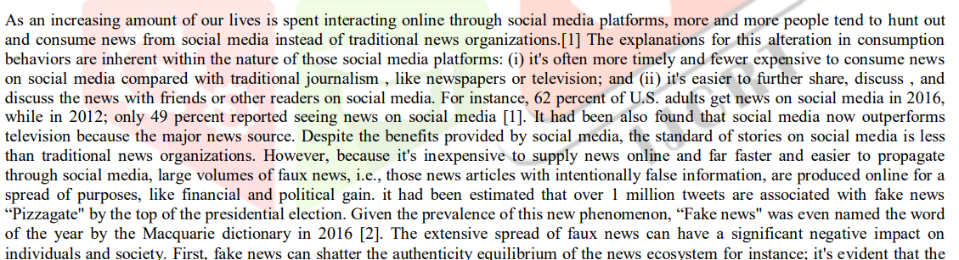
RESEARCHS AND REFERENCE
Link of research--https://www.researchgate.net/publication/339022255_A_smart_System_for_Fake_News_Detection_Using_Machine_Learningl
The reference is taken from the youtube and some of the Articles , and the dataset is taken from the Kaggle
youtube link→
https://youtu.be/5X27excCyXk

Slide 7





Algorithm Used
STUDIO SHODWE
→Naive bayes
→Decision Tree
→Logistic
Regression
→Random forest classification
→gradient boost classifier

Slide 8


Methodology
1
--> The main goal is to apply a set of classification algorithms to obtain a classification model in order to be used as a scanner for a fake news by details of news detection and embed the model in python application to be used as a discovery for the fake news data [m][n].
2
--> Also, appropriate refactorings have been performed on the Python code to produce an optimized code[m][n].
3 --> A tool is implemented for detecting the fake articles. In this method supervised machine learning is used for classifying the dataset.

Slide 9




Methodology
4
--> The main programming languages used in this project is PYTHON Programming languages and the most of its python's framework pandas ,numpy,metplotlib and sckit learn
5 --> The data is divided it into two parts: The first section, which consists of 75% of the data, is a trained data, where the algorithm detects the real news and false news
,then the data is labeled in the form of 0 and 1 where 0 is for false news and 1 for true news.

Slide 10


Implementation
---> the dataset we working on is two types one of them is true data and false data which is represented by 1 and 0
---> For the implementation purpose, the four existing approaches are considered. The results of three models(RFC,DT,GBC,NAIVE BAYES) are compared with the proposed model, it is found the accuracy among top 20 results.
---> The demonstration is done using python programming on jupyter notebook and some machine learning algorithm and python libraries

Slide 11
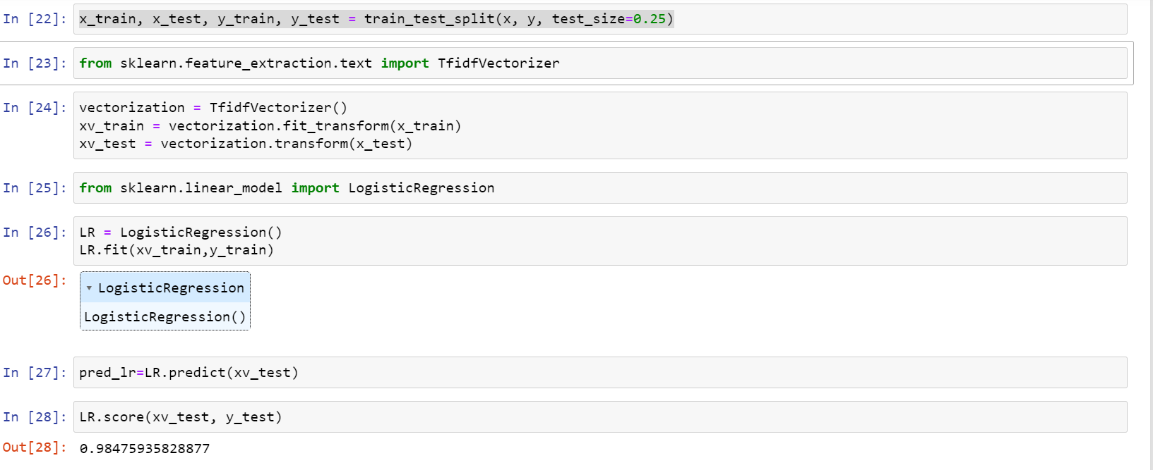
Snapshot And Outcome

Slide 12
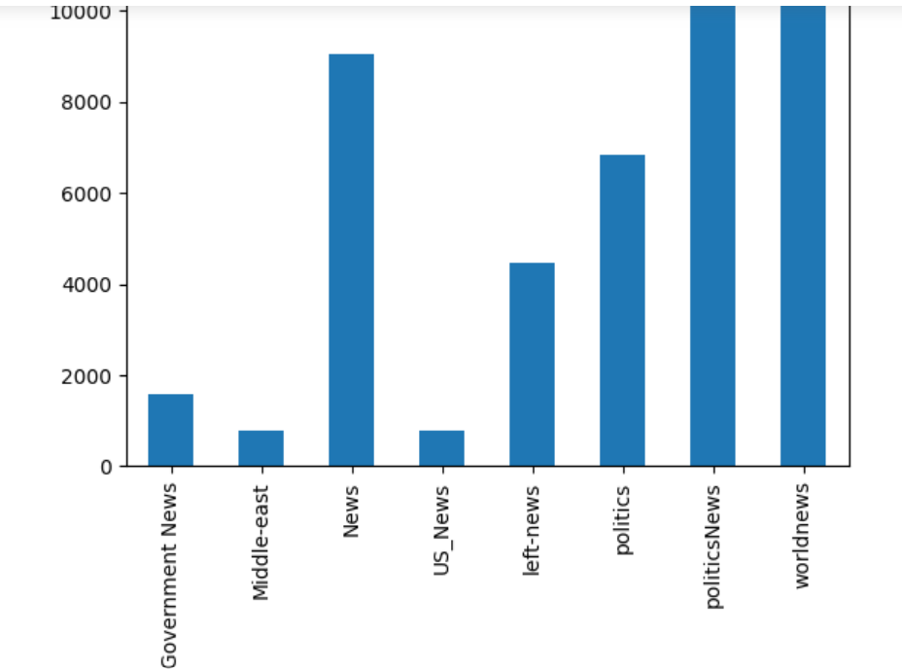
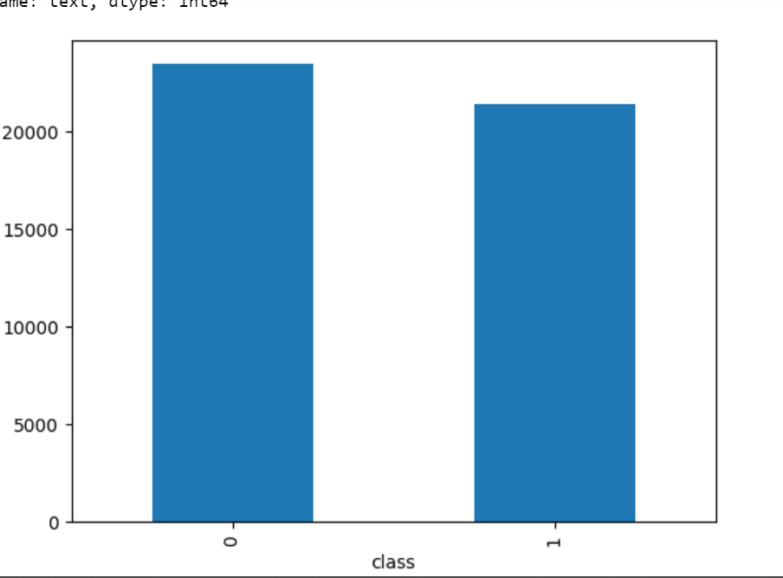
Snapshot And Outcome

Slide 13
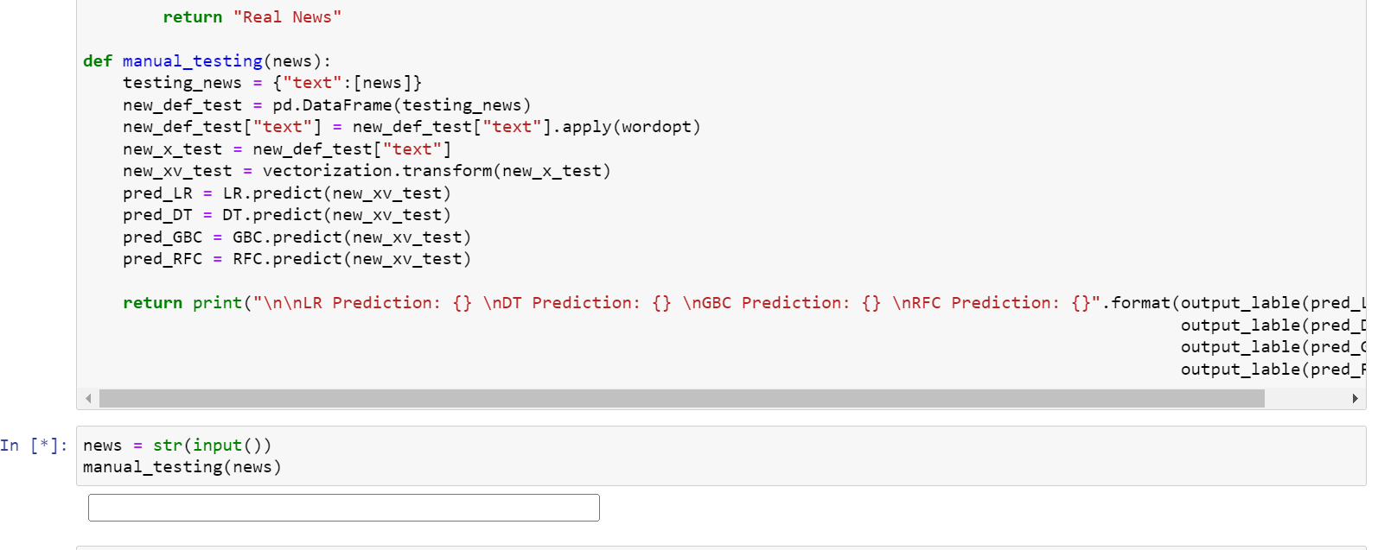
Snapshot And Outcome

Slide 14
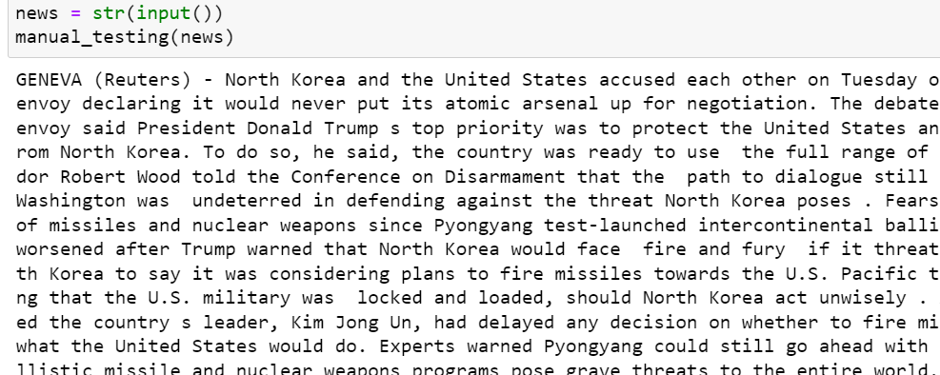
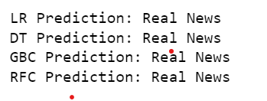
Snapshot And Outcome

Slide 15
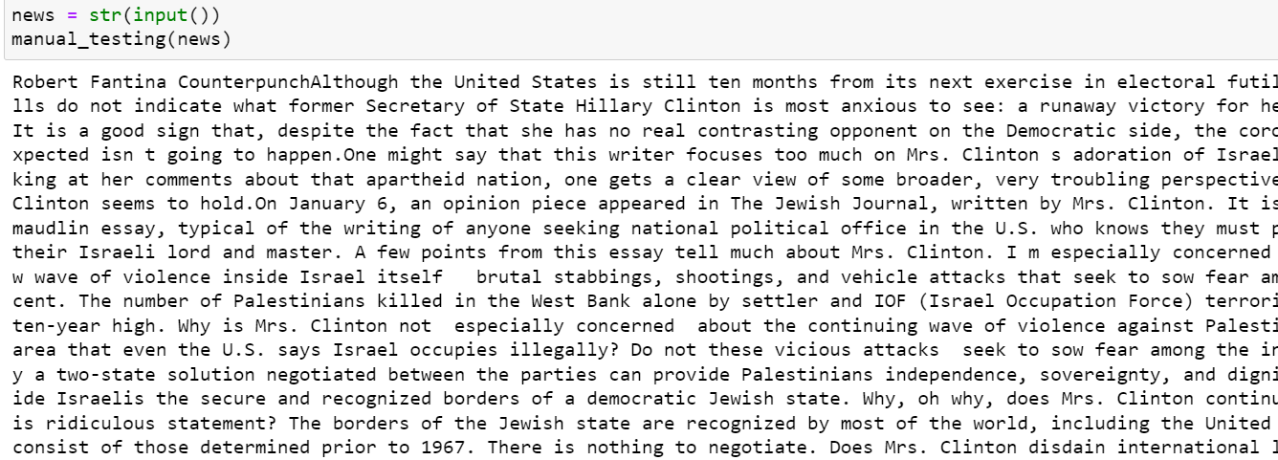
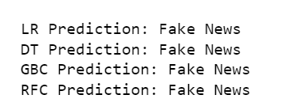
Snapshot And Outcome

Slide 16


REQUIRED SOFTWARE
OPERATING SYSTEM--WINDOWS 10/11 OR LINUX
PROGRAMMING LANGUAGE-- PYTHON
PYTHON LIBRARIES-- NUMPY,PANDAS,METPLOTLIB,SCIKIT LEARN
DATABSE--MY SQL/MONGO DB
MAINLY THE DATASET IS TAKEN FROM THE KAGGLE IN TWO FORM TRUE DATA AND FALSE DATA

Slide 17






Thank You

